Slide 1
Team 4 Website Status
Presented By James Feeney
Notes:
Introduce the team name
-Mention your goal “To update you on our progress for the webpage”

Slide 2
Table of Contents
Our Client and Goal
Previous Status
Update Changes
Challenges
Future Plans and Roadmap
Notes:
-Pretty much give the rundown on the outline

Slide 3
Client: The Niklewski Family
The Niklewski family, who have grew to different corners of the world desperate for a way to share the family recipes
Our Goal: to help them by providing a webpage where they can access their recipes easily and effectively with many features aimed to personalize the Niklewski households
Notes:
-Might need to be retold the lore here
-Regardless of edits we wanna say this “Our goal is to help them by providing a webpage where they can access their recipes easily and effectively with many features aimed to personalize the Niklewski households”

Slide 4
Previous Project Status
Notes:
Introduce the team name
-Mention your goal “To update you on our progress for the webpage”

Slide 5
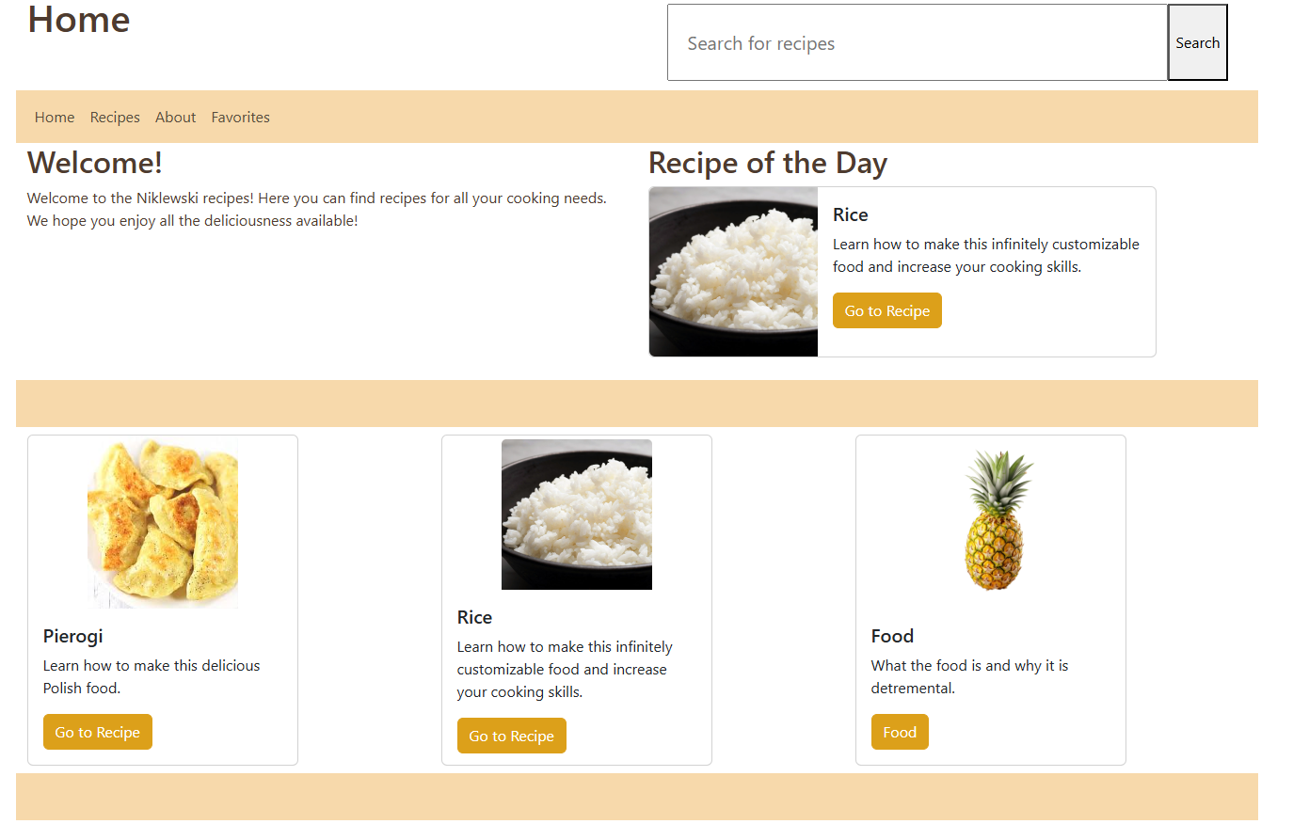
Home Page (Old)
Notes:
-Homepage and recipe page both implemented
-Search bar fully functional
-Filter bar was implemented but not at all ready
-Actual recipe individual page layout with a test dummy

Slide 6
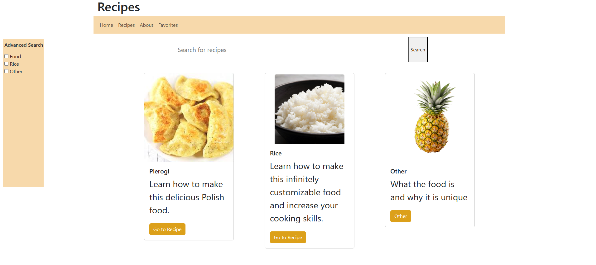
Recipe Search Page (Old)
Notes:
-Homepage and recipe page both implemented
-Search bar fully functional
-Filter bar was implemented but not at all ready
-Actual recipe individual page layout with a test dummy

Slide 7
What we changed
Homepage cards style improved
Homepage cards are clickable
Recipes display when loading the page
Notes:
-Added the functionality to the filter bar
-A fully operational and filter bar implemented favorites page
-A submission form to allow Niklewskis to add more stuff
-Whatever else I am told was added

Slide 8
What we added
Introduced advanced search filters
Added a Favorites section
Implemented the submission form
Implemented card automatic layout
Interactive ingredient checklist for Recipe Page
Seasonal Section for Home Page
Upgraded Visual Design
Notes:
-Added the functionality to the filter bar
-A fully operational and filter bar implemented favorites page
-A submission form to allow Niklewskis to add more stuff
-Whatever else I am told was added

Slide 9
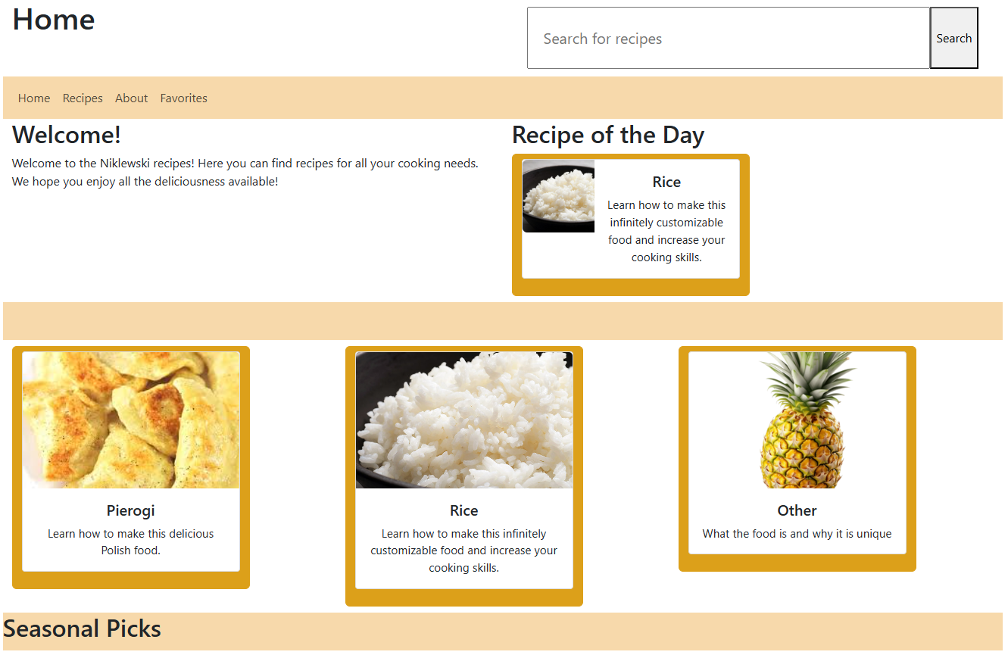
Home Page (New)
Notes:
-Homepage and recipe page both implemented
-Search bar fully functional
-Filter bar was implemented but not at all ready
-Actual recipe individual page layout with a test dummy

Slide 10
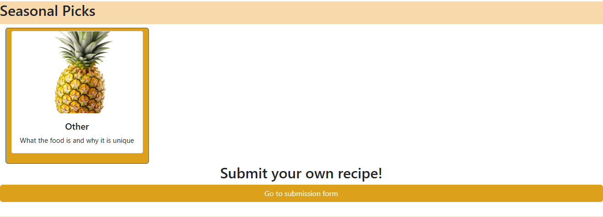
Seasonal Section

Slide 11
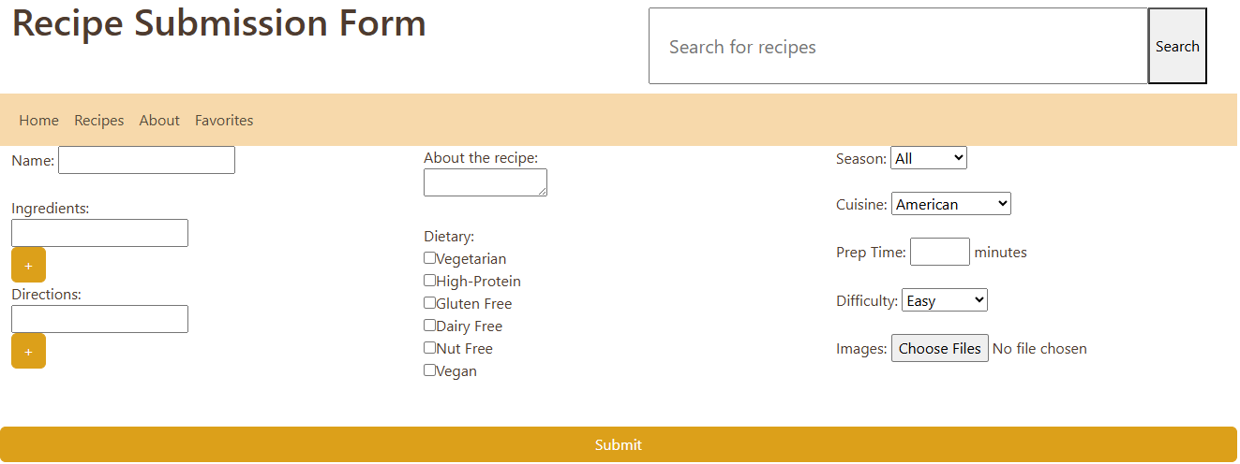
Submission Form Page

Slide 12
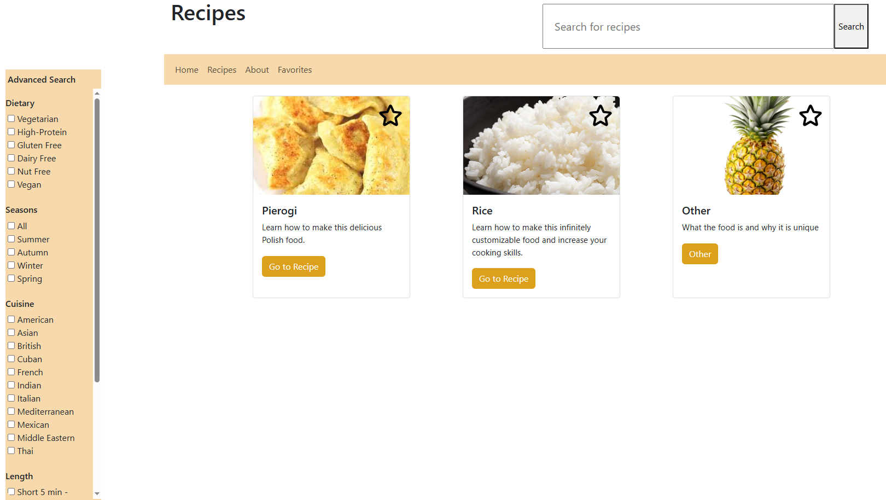
Recipe Page (New)

Slide 13
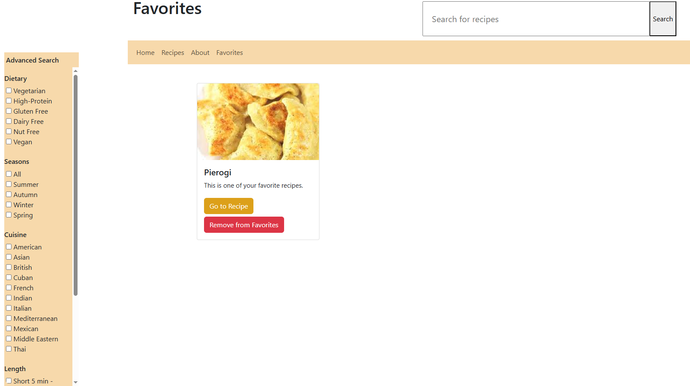
Favorite Page

Slide 14
Challenges
Breaking Card Style
Maintaining functional filters across pages
Seasonal section display issues
Button functionality inconsistencies
Notes:
-Bloody cards mate kept breaking style
-favorite page with search bar implementation was rough, and the filtering never wanted to work
-bringing over the cards with their filter bar compatibility was rough
-Whatever other problems people had
-I also wanna say maybe that github was involved lmao

Slide 15
Roadmap: Main Features
Visual Design = Finalized April 14th
Mobile Support = April 14th
Styling and Animations = In-Progress
Recipe Implementation = Pending
Browser Compatibility = Pending
Notes:
-Future me problem

Slide 16
Roadmap: Bonus Features
Recipe Submission = Completed
Recipe Categories = Completed
Recipe Dynamic Sorting = Completed
Seasonal Section = Completed
Interactive Ingredient Checklist = Completed
Animations for Recipe Actions = In-Progress
Appealing Mobile Design = In-Progress
Animations for Recipe Preparation = Pending
Theme Switcher = Pending
Notes:
-Future me problem

Slide 17
Live Demo Time

Slide 18
Questions?

